Slide 1
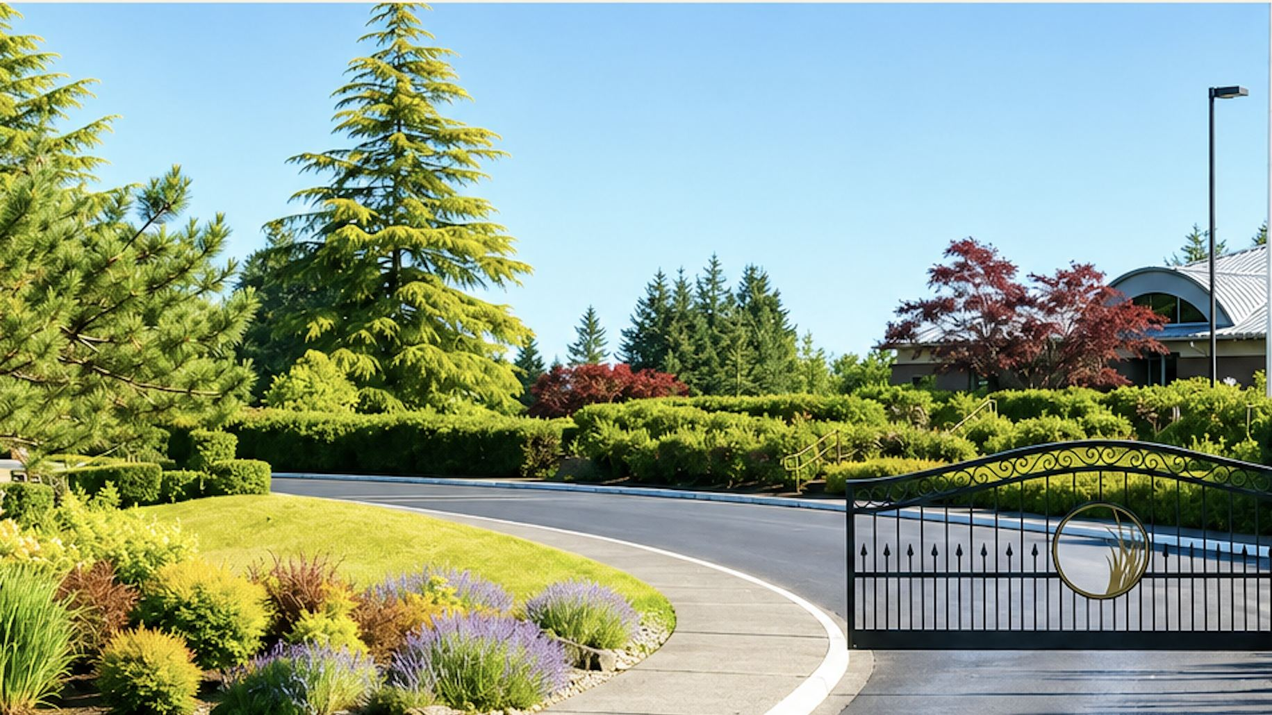

INDIAN SUMMER HOMEOWNERS ASSOCIATION
New Resident
Orientation 2026
Welcome home — we're glad you're here.
Olympia / Lacey, Washington · ishoa.org
Notes:
Welcome everyone. Introduce yourself, then ask Board and Committee members in the room to stand and introduce themselves. Then go around the room and let each new resident say their name, their street, and where they moved from.

Slide 2
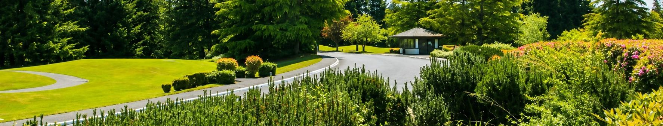
NEW RESIDENT ORIENTATION
We're glad you're here
A quick tour of how Indian Summer works — and how you fit into it.
01
Our Story
02
The Land
03
Two Organizations
How Indian Summer grew from a
golf course into a neighborhood
Sub-neighborhoods, the Nature Preserve, the Trail & Chambers Park
How the HOA and the Golf Course operate separately — together
04
How We Govern
05
The Committees
06
Getting Involved
CC&Rs, your Board, VIS
Management and the sub-HOAs
Ten teams of neighbors doing the actual work
Events, clubs, and the two hours a week that keep this place special
Notes:
Set expectations: about 45 minutes, questions welcome throughout. Everything on these slides also lives on ishoa.org.

Slide 3
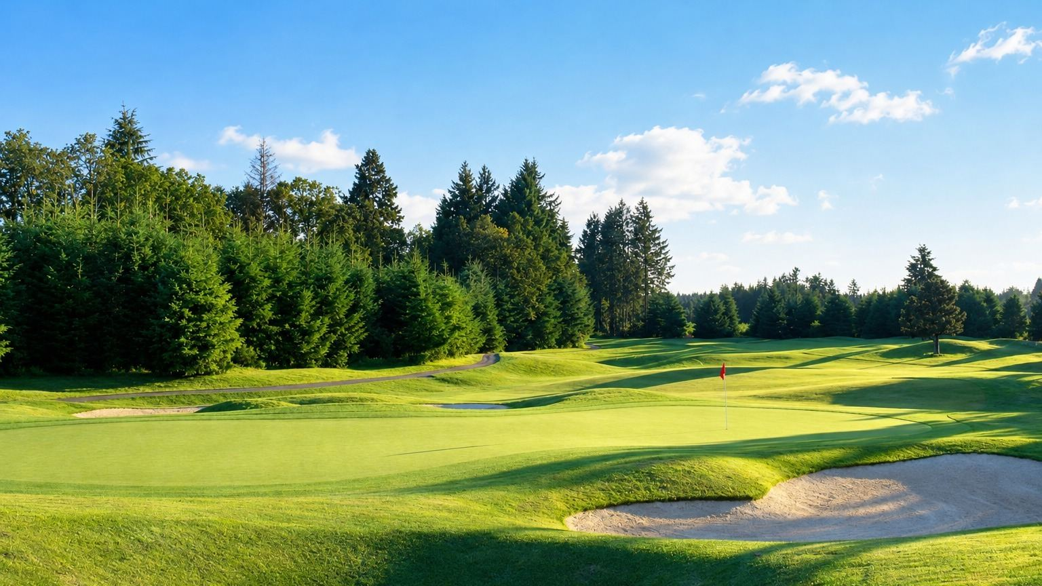
PART ONE
Our Story
A golf course came first. The neighborhood grew up around it.
Notes:
Transition: Indian Summer is unusual — the golf course was here before the houses were.

Slide 4
HOW INDIAN SUMMER WAS FORMED
From fairways to front porches
Eight years that built the community you just moved into.
1992
1993
1998
The golf course opens
The HOA is incorporated
Kinsale is created
Indian Summer Golf & Country Club opens on Chambers Prairie — a Peter L. H. Thompson design set in old-growth forest and water.
Indian Summer Homeowners Association is formed. Troon, Turnberry and a small portion of Prestwick are platted first.
The community expands with the addition of the Kinsale neighborhood.
1999
2000
2000s
Bellevita Townhomes begin
Prestwick Ln reaches Rainier Rd
The Links & Chambers Park
Our first attached-home neighborhood breaks ground.
Prestwick Lane is extended through to Rainier Road, opening a second gated entrance.
The Links is created, and the historic Chambers homestead site becomes a community park under long-term lease.
Notes:
Key point: the building phases explain why streets, lot sizes and even the rules feel a little different from one part of Indian Summer to the next.

Slide 5
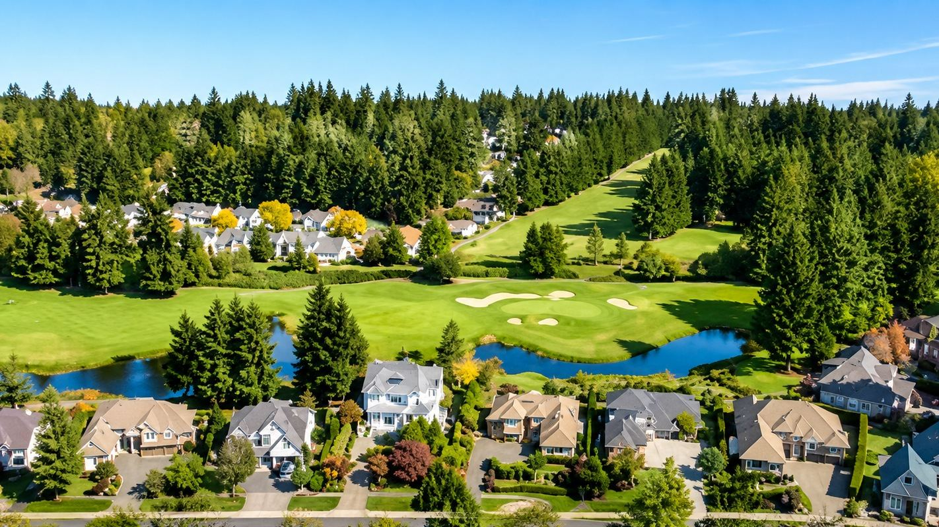
HOW THE NEIGHBORHOOD IS LAID OUT
One community,
several neighborhoods
Indian Summer wraps around the golf course. Three gated entrances — including the Rainier Road gate at Prestwick Lane — feed a network of internal neighborhoods, pocket parks and common areas.
Troon, Turnberry & Prestwick — the original 1993 neighborhoods
Kinsale (1998) and Kinsale Row
Bellevita Townhomes (1999)
The Links, Greenside Court and Fairway at 7
Pocket parks, retention ponds and the 33-acre Nature Preserve
Four of these are sub-HOAs with their own boards and dues.
Notes:
Point out that a resident may belong to both ISHOA and a sub-HOA and pay both. Ask new residents which street they're on.

Slide 6
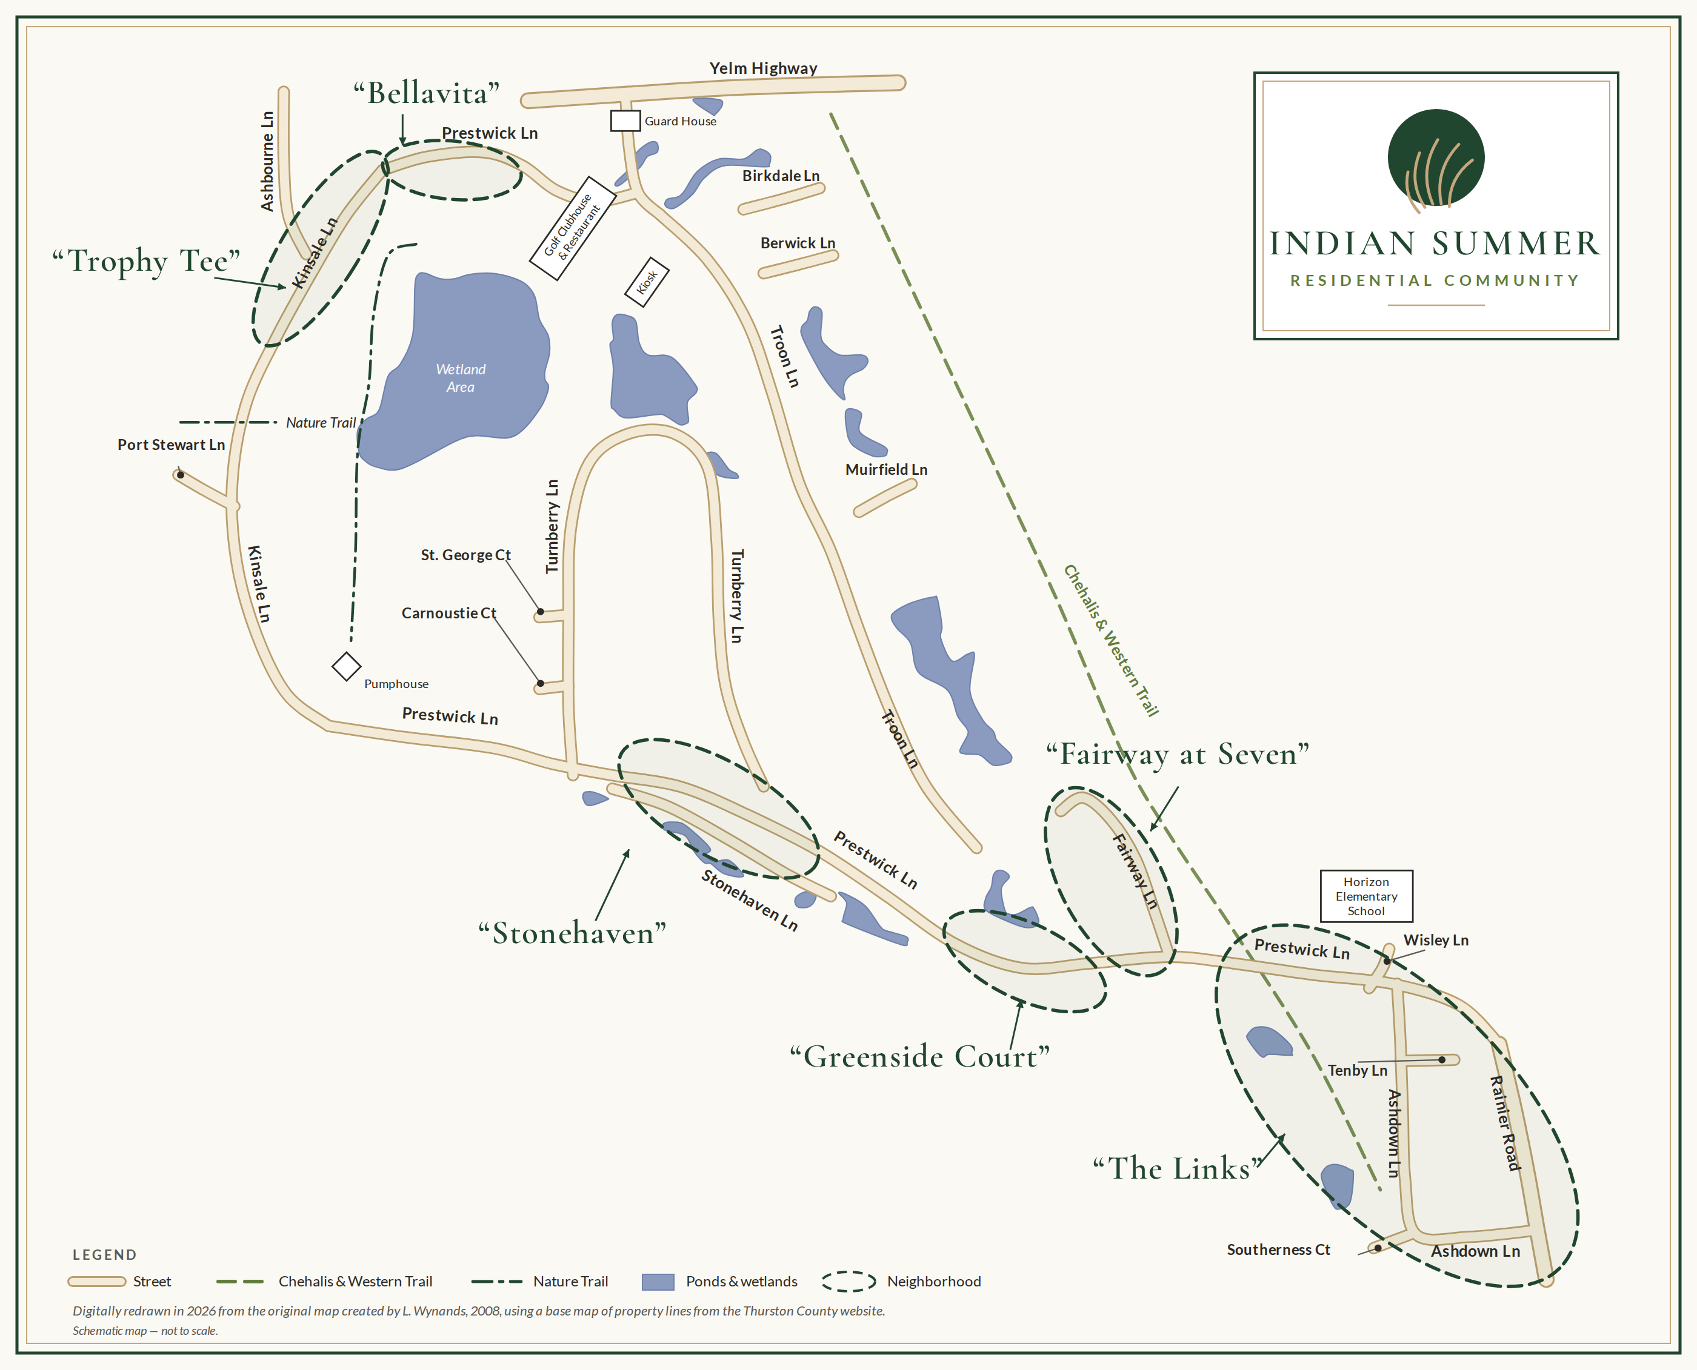
COMMUNITY MAP
Finding your way around
Every street, gate and neighborhood in Indian Summer, from the Yelm Highway entrance to the Rainier Road gate. The dashed outlines mark the named neighborhoods; four of them are sub-HOAs with their own boards.

Slide 7
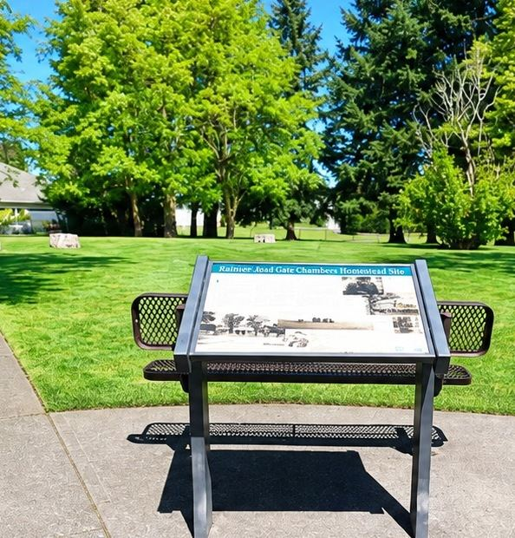
RAINIER RD SE & PRESTWICK LN SE
Chambers Historical Park
A piece of Washington Territory history sits just inside our Rainier Road gate.
In 1855, settlers on Andrew Chambers' land claim built a blockhouse here for shelter during the Washington Indian War. It sheltered about fourteen people and was abandoned within the year — no attack ever came.
Today a historical marker and interpretive sign stand at the northwest corner of Rainier Rd SE and Prestwick Ln SE.
ISHOA holds the site under a long-term lease with Thurston County and pays to maintain it.
The gated lawn hosts the Pet Committee's Puppy Parties and other small community gatherings.
Also known as the Andrew Chambers Blockhouse, or Fort Chambers — one of several settler blockhouses built across Thurston County in 1855.
Notes:
A nice detail for newcomers: they drive past a 170-year-old historic site every day. Mention that the Pet Committee's puppy parties are held there.

Slide 8
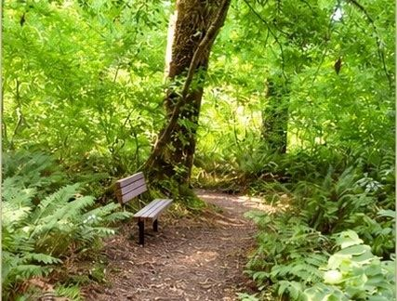

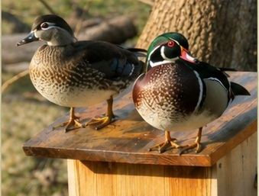
PART TWO · THE LAND AROUND US
Our 33-acre Nature Preserve
Undeveloped forest and a seasonal pond, right inside the neighborhood.
2/3 mile
33 acres
7 nest boxes
Walking trail with one side branch, maintained by volunteers
Undeveloped forest and a large seasonal pond — home to screech owls, heron and trillium
Wood duck boxes at the pond margin, cleaned by volunteers each year
Homeowners chose more than 20 years ago to leave this tract wild. The southern trailhead and bulletin board are on Prestwick Lane.
Notes:
The Preserve is one of the things that makes Indian Summer different from other gated golf communities. It exists because residents chose not to develop it.

Slide 9
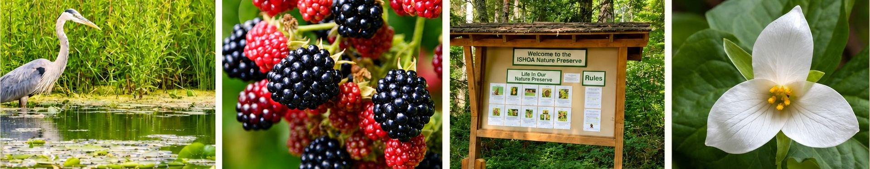
USING THE PRESERVE
Walk it, watch it, leave it as you found it
Great blue heron, wood ducks, screech owls, trillium — all within a short walk of your door. A few simple rules keep it wild.
Foot traffic only — no bicycles or wheeled vehicles
No pets on the Preserve trail
Closed after dark
No fires or fireworks; do not damage plants or wildlife
No trash cans on site — pack out whatever you bring in
Wildlife concerns such as coyotes go to Thurston County
The species identification board and interpretive signs are posted at the Prestwick Lane trailhead.
Notes:
Emphasize 'no pets' — this surprises new dog owners who assume the Preserve is a dog-walking trail. Point them to the Chehalis-Western Trail instead.

Slide 10
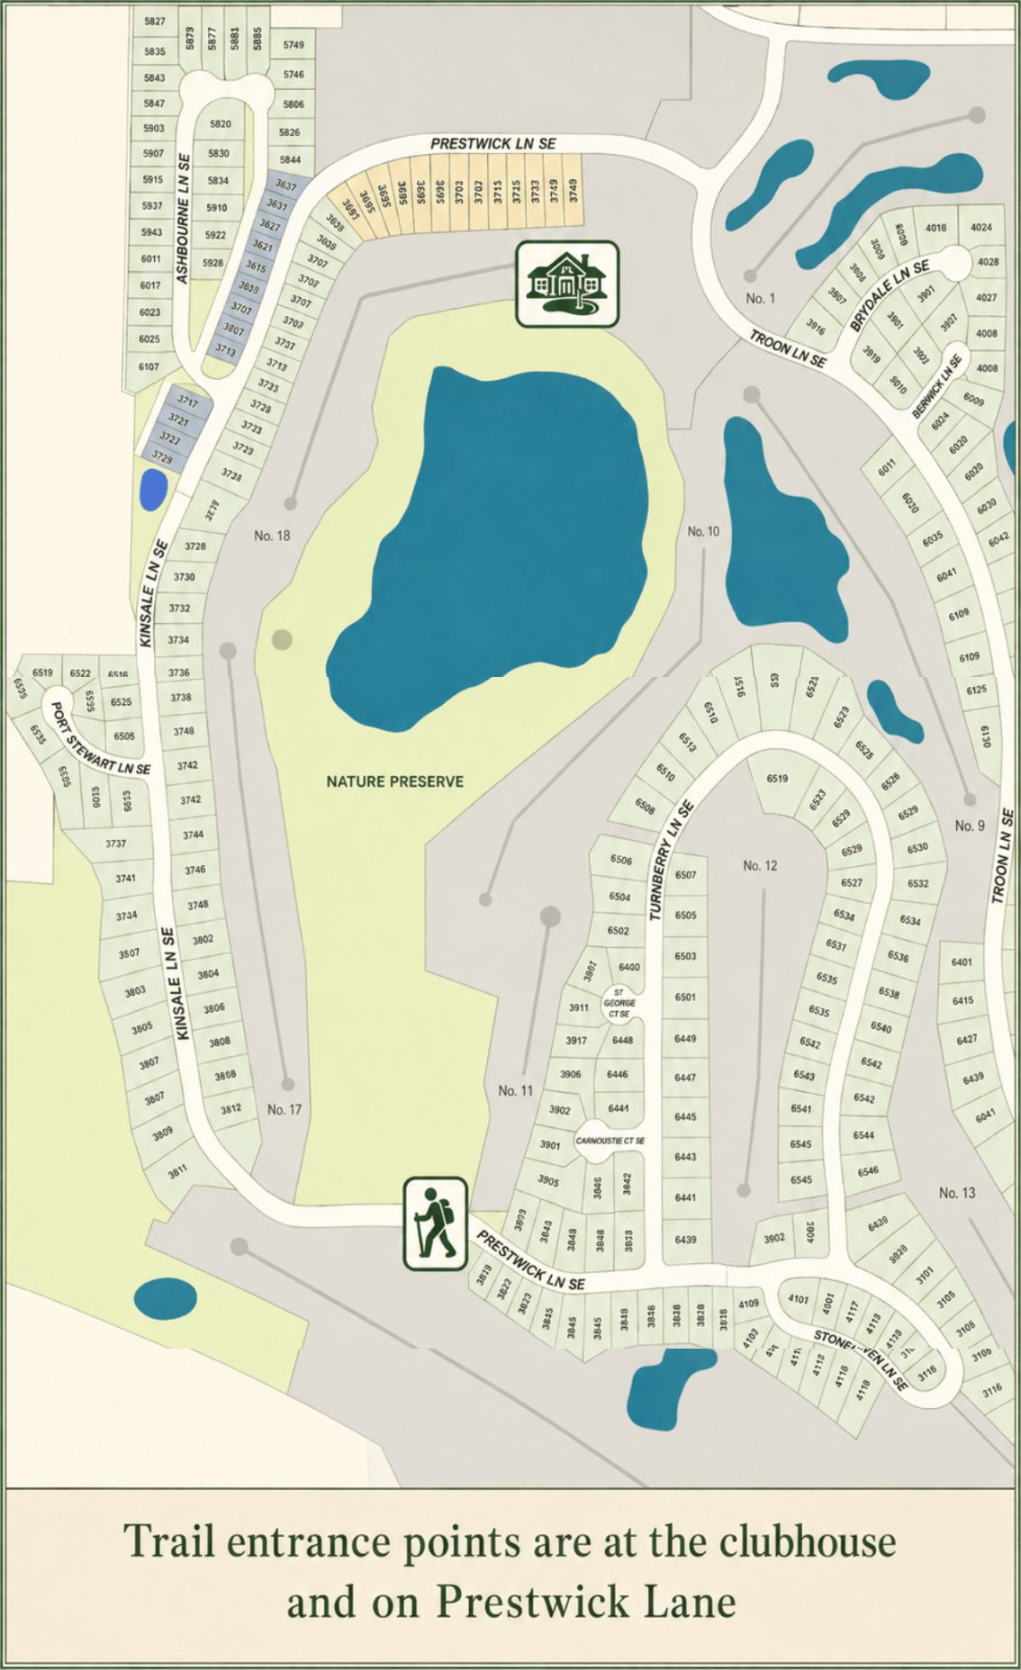
NATURE PRESERVE · TRAIL MAP
Two ways onto the trail
Trail entrances are at the clubhouse and on Prestwick Lane SE, by the bulletin board. The two-thirds-mile trail winds through 33 acres of forest and past the seasonal pond — the hiker marks the Prestwick entrance.

Slide 11
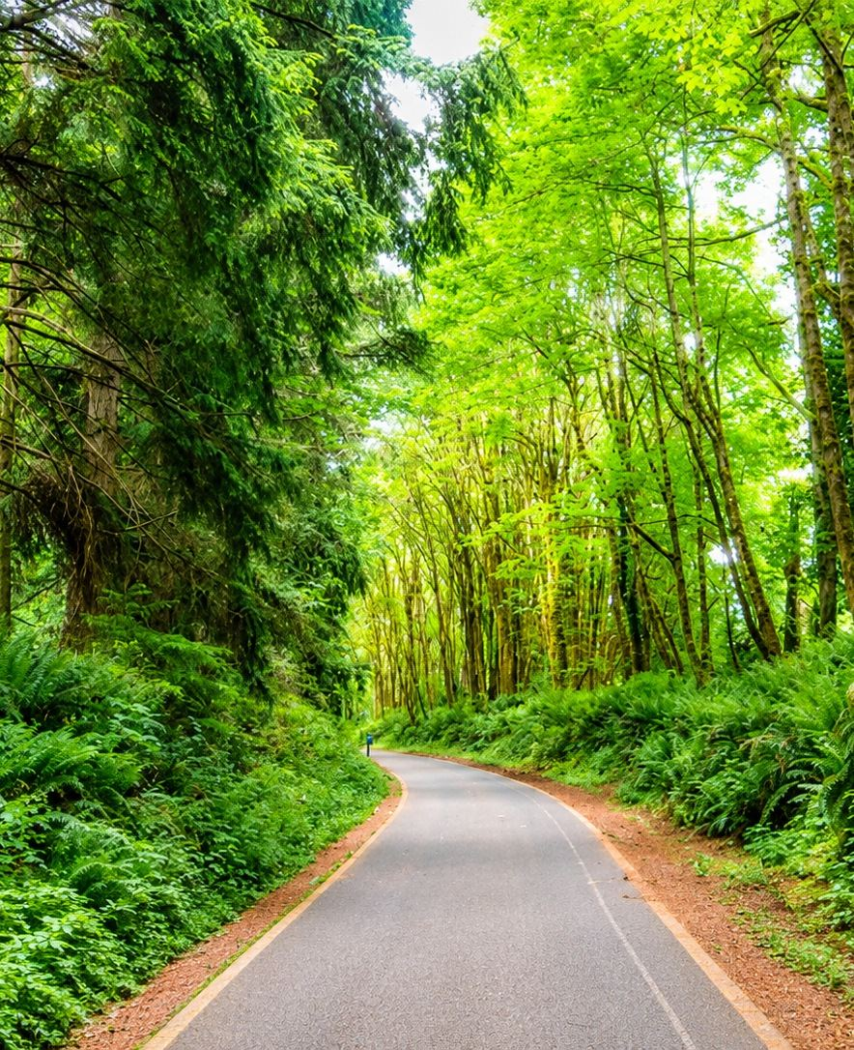
22 PAVED MILES THROUGH THURSTON COUNTY
The Chehalis-Western Trail
A regional rail-trail runs right along our community — and you can get on it without leaving the neighborhood.
Runs north–south from Woodard Bay on Puget Sound to Vail, and crosses the Yelm–Tenino Trail
Access from inside Indian Summer is through the gates on Prestwick Lane, next to the Fairway at 7 Townhomes and The Links
The large "swing" gates are for vehicles — watch for walkers and cyclists as you drive through
Smaller "slider" gates on each side are for golf carts and pedestrians
The keypad code is printed in your ISHOA Resident Handbook
Leashed dogs are welcome on the Trail. Trail hours are 9 a.m. to dusk.
Notes:
This is a real amenity — mention Mount Rainier views and the Chambers Lake overlook. The trail is maintained by the City of Lacey and Thurston County, not by us.

Slide 12
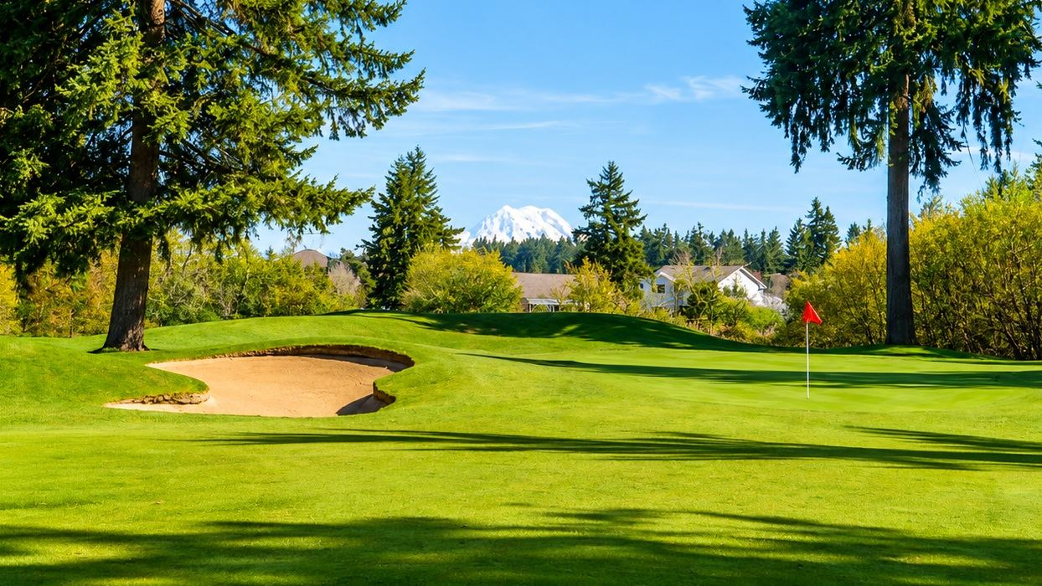
PART THREE
Two organizations, one community
The HOA and the Golf Course are separate — and they share a fence line.
Notes:
This is the single most misunderstood thing by new residents. Slow down here.

Slide 13
SEPARATELY, BUT TOGETHER
Who does what
Two independent organizations, one shared address.
Indian Summer HOA
Indian Summer Golf & Country Club
A Washington non-profit corporation, incorporated in 1993 and governed by five volunteer directors elected by homeowners.
Owns and maintains the streets, sidewalks, gates, guardhouse, common areas, pocket parks, storm water systems and the Nature Preserve.
Funded by your HOA dues. Every homeowner is a member — membership is not optional.
A privately operated golf club and clubhouse — a separate business with its own management, members and staff.
Owns and maintains the course, the cart paths, the ponds on the course, the Clubhouse and Embers Restaurant.
Golf membership is optional and separate from HOA dues. Embers is open to the public.
Where they meet: shared boundaries, shared views, and a shared interest in keeping Indian Summer beautiful. The CC&R Rewrite Committee is currently reviewing how the two relate in our governing documents.
Notes:
Say it clearly: paying HOA dues does not make you a golf member, and golf membership does not exempt you from HOA rules.

Slide 14
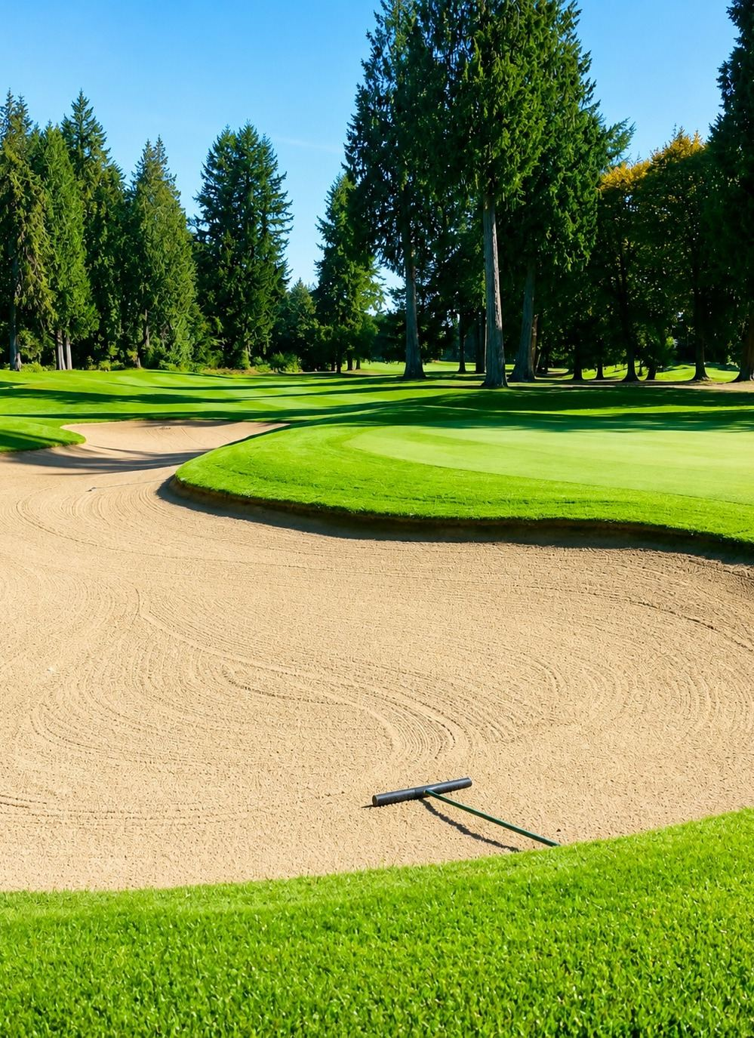
WHAT RESIDENTS SHOULD KNOW
The course is private property
Living on a fairway does not come with access to it.
Only Golf & Country Club members who have checked in at the Pro Shop may use the course
No dog walking, and no walking on the cart paths
Children and pets may not play in the fairways, sand traps or ponds
Course restrooms are for golfers who are actively playing
Embers Restaurant in the Clubhouse is open to the public — everyone is welcome
Pro Shop (360) 459-3772 · Golf Course (360) 923-1075 · Embers Restaurant (360) 459-4572
Notes:
Frame this positively: the course is beautiful to look at and easy to enjoy from the Clubhouse. Mention Wine Club and Thirsty Thursdays as ways non-golfers use the Clubhouse.

Slide 15
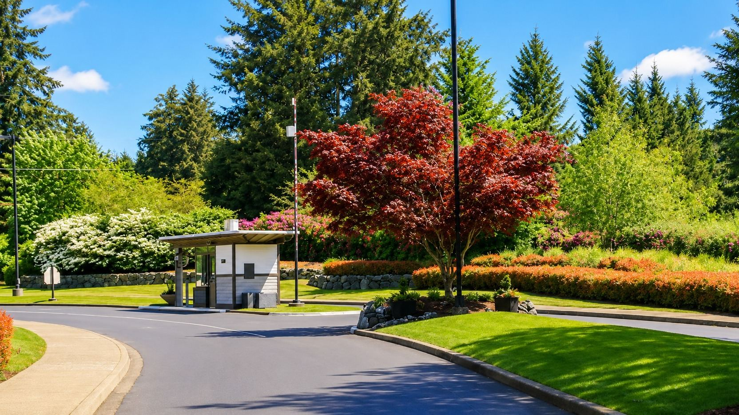
PART FOUR
How we govern ourselves
Documents, a volunteer board, a management company — and you.
Notes:
Transition into governance. Keep it light; the detail is all on the website.

Slide 16
GOVERNANCE
The documents that run Indian Summer
In order of authority — each one has to agree with the one above it.
Washington State Law
RCW 64.90, the Washington Uniform Common Interest Ownership Act, sets the legal floor for how associations like ours must operate.
Articles of Incorporation
Filed in 1993. Establishes ISHOA as a Washington non-profit corporation.
CC&Rs
Covenants, Conditions & Restrictions — amended and restated in 2009, amended again in 2014. The rules that run with your land.
Bylaws
Second Amended Bylaws (2004). How the Association elects and runs its Board.
Board & ARB Policies
Day-to-day rules adopted by the Board, including ARB Policies 1–13 and ADM Policy 09.
All of these documents are available to you through the VIS Management FrontSteps portal and at ishoa.org.
Notes:
Tell them: you agreed to the CC&Rs when you bought. Encourage them to actually read them — and to send comments to the CC&R Rewrite Committee.

Slide 17
ORGANIZATION CHART
How the pieces fit together
Revised July 2026.
Architectural Review Board
INDIAN SUMMER BOARD OF DIRECTORS
VIS Management
CC&R Rewrite Task Force
Finance Committee
Communications
Community Liaison
Maintenance
Security
Nature Preserve
Pet Committee
SUB HOMEOWNER ASSOCIATIONS
Bellevita
Greenside Court
Fairway at 7
Kinsale Row
Notes:
Walk it top to bottom. The Board sets direction, VIS executes, committees do the work, and the sub-HOAs govern their own smaller areas.

Slide 18
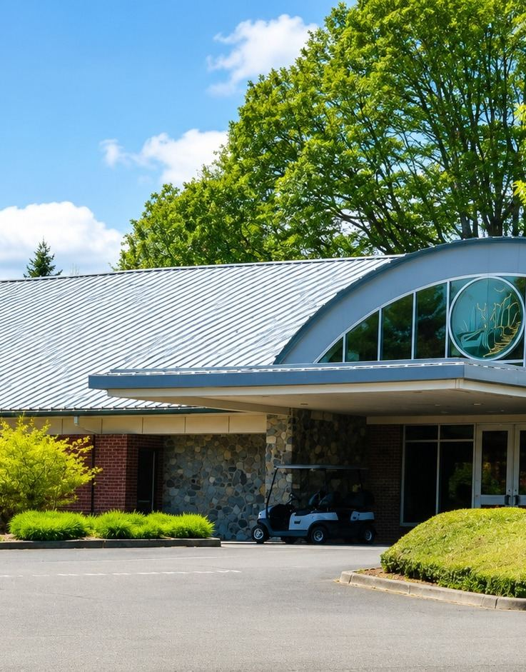
YOUR 2026 BOARD OF DIRECTORS
Five volunteer neighbors
Elected by homeowners at the Annual Meeting each November, for staggered two-year terms.
PRESIDENT
Jeff Lawrence
VICE PRESIDENT
Don Lewis
SECRETARY
Jeanne Johnson
TREASURER
Gerald Hamilton
MEMBER AT LARGE
Terry Rupp
Board meetings are held the 4th Monday every month in the Clubhouse Fireside Room (or connect via Zoom) at 5:30 pm April–October and 3:30 pm November–March. Homeowners are welcome to address the Board at the start of each meeting.
Notes:
Have the Board members present stand up. Stress that homeowners are welcome at every meeting and can address the Board at the start.

Slide 19
WHO TO CALL
VIS Management & the Sub-HOAs
The Board sets policy. A professional management company handles the day-to-day.
VIS Community Management
Pacific Coast Security
Our professional property management company. Handles dues and payments, gate registration and RFID access, compliance letters, records, and the VIS FrontSteps owner portal.
8617 Martin Way East, Lacey · (800) 537-9619
Staffs the guardhouse and runs a nightly roving patrol.
Guardhouse hours: Monday–Friday, 6:30 a.m. – 4:30 p.m.
Guardhouse (360) 438-9256 · Thurston County Sheriff (360) 786-5500
Four neighborhoods inside Indian Summer also have their own sub-associations
Bellevita
Greenside Court
Fairway at 7
Kinsale Row
If you live in one of these, you belong to both ISHOA and your sub-association — each with its own board, dues and rules. Sub-HOA president contacts are on the Contacts page at ishoa.org.
Notes:
Ask for a show of hands: who lives in a sub-HOA? Point them to their sub-HOA president.

Slide 20
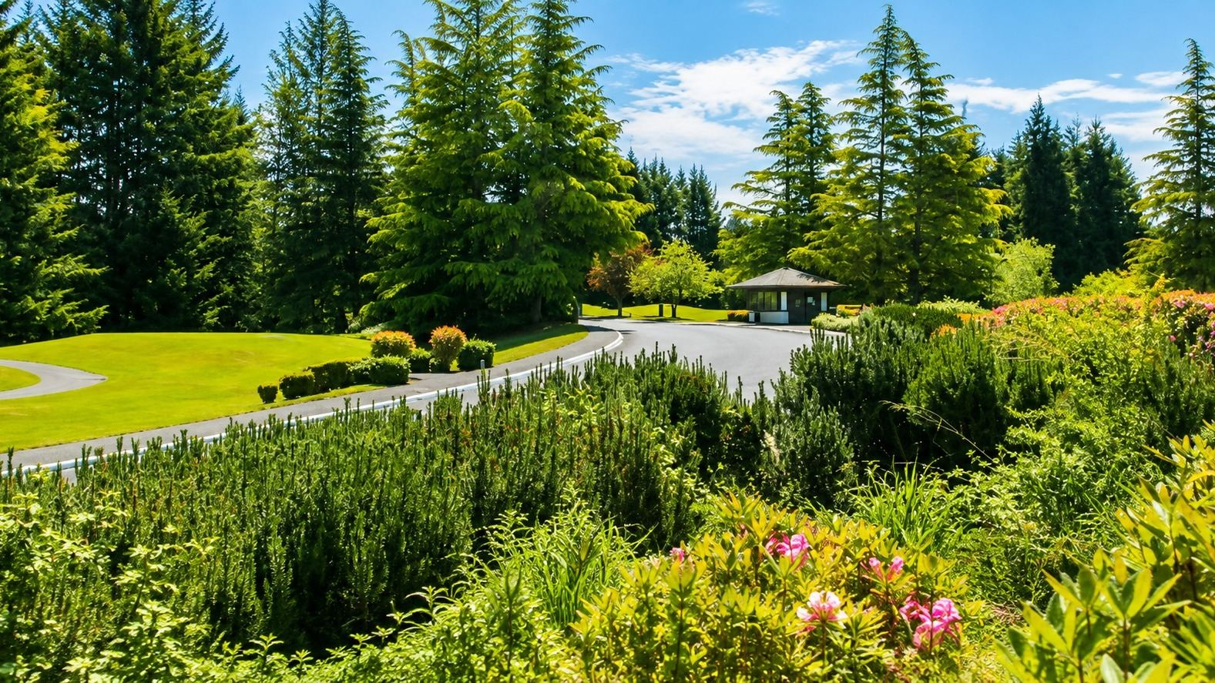
PART FIVE
Volunteers are the heart of ISHOA
Every gate, sign, party, trail and flower bed is a neighbor who decided to care.
Notes:
This is the emotional center of the talk. Slow down. Name a few of the volunteers who are in the room.

Slide 21










THE COMMITTEES
Ten teams of neighbors
Open any of these on ishoa.org to meet the people behind them — and every one of them would welcome your help.
ARB
Maintenance
Community Events
Finance
Pet Committee
Approves exterior and landscaping changes
Streets, common areas, ponds, mailboxes
Picnic, garage sale, holiday party, annual meeting
Budget, audits, reserve study, investments
Good pet citizenship &
Puppy Parties
Security
CC&R Rewrite
Nature Preserve
Communications
Clubs
Gates, cameras, guardhouse, traffic safety
Modernizing our CC&Rs and Bylaws
The trail, nest boxes and interpretive signs
Website, signs, text alerts, Resident Handbook
Book Club, Mahjong, Wine Club, Thirsty Thursdays
Most committees ask for an average of about two hours a week — eight hours a month. Nobody is expected to do it all.
Notes:
Read a couple of the taglines out loud, then say: the next slides walk through what each one actually does.

Slide 22

COMMITTEE · ARCHITECTURAL REVIEW BOARD
Ask before you build
The ARB helps homeowners with any exterior change — and protects everyone's property values in the process.
Submit an ARB application before you start work on:
Construction, remodels and re-roofing
Solar panel installation
Exterior painting and fencing
Hardscape installation
Landscaping changes — bed shape, size or ground cover
Tree removal
Some things need no approval — for example, planting or removing annual flowers, refreshing the bark in an existing planting bed, routine pruning of trees and hedges, or removing dead shrubs. Check your ARB Policy for the exact details.
Applications are under FORMS at ishoa.org · Committee meets the 2nd Thursday of each month at 10 a.m. · Guided by CC&Rs Articles III & IV and ARB Policies 1–13.
Notes:
The most common new-resident mistake is painting or fencing first and asking later. Encourage them to call the ARB chair before they hire a contractor.

Slide 23
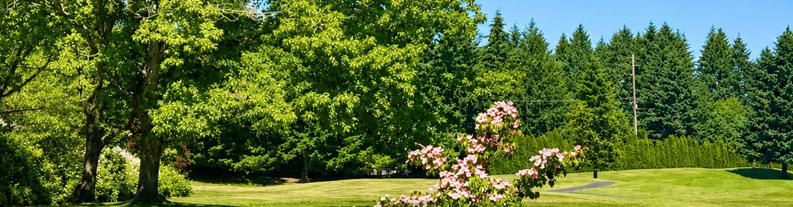
COMMITTEE · MAINTENANCE
Keeping the common ground beautiful
Nine resident volunteers and a Board liaison — retired executives, a physician, a landscape designer, a contracts manager.
What they look after
Landscaping and irrigation across all common areas
Streets, sidewalks and storm water systems
Electrical and water utilities, and mailbox installation
Volunteers walk pocket parks and check ponds after heavy rain
Notices go up before each quarterly street sweeping
Contractors do the physical work — no shovel required
See something broken? Use "Notify Maintenance of a Problem" on the ishoa.org home page — or email ismaintenancecommittee@gmail.com.
Notes:
A great entry point for volunteers with construction, irrigation or landscaping backgrounds — but stress that it is oversight, not manual labor.

Slide 24
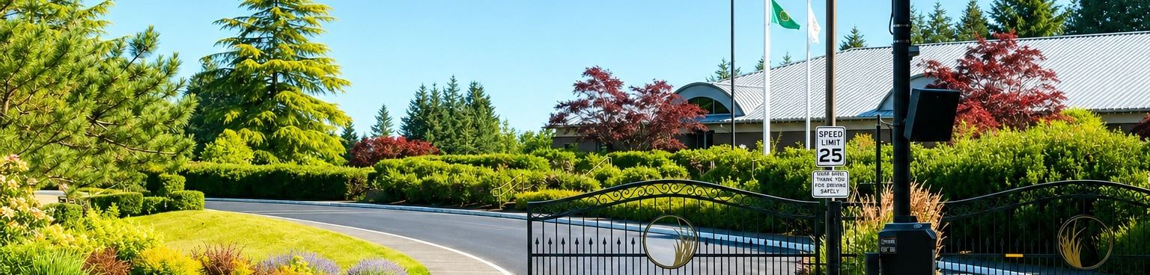
COMMITTEE · SECURITY
Gates, cameras and good habits
Indian Summer is a gated community — but not a secured one by police standards. Good neighbors are the other half of the system.
Getting in and out
Keeping it safe
RFID tags are $20 from VIS and open all three gates
Gate keycards for family or hired help are $12
The Cellgate app opens any gate from your phone
Visitors use the gate touchscreen to call your registered phone — press 1 to talk, then * to open
25 mph limit, speed humps, radar signs and speed cameras
Close garage doors; lock cars left in the driveway
Leave exterior lights on at night and lock your doors
Call the guardhouse to report a solicitor, suspicious activity, a theft, or a scheduled delivery
Guardhouse (360) 438-9256, Monday–Friday 6:30 a.m.–4:30 p.m. · Nightly roving patrol by Pacific Coast Security · Sheriff (360) 786-5500
Notes:
Cover the four basics out loud: garage doors closed, cars locked, exterior lights on, doors locked.

Slide 25
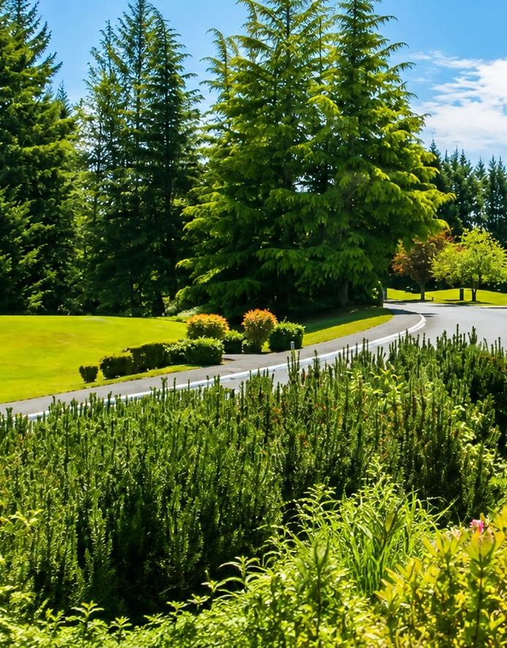
COMMITTEE · PETS
A pet-friendly neighborhood
The Pet Committee promotes good pet citizenship, organizes gatherings, and helps neighbors sort out pet concerns.
Puppy Parties and other get-togethers at the gated Chambers Park site, just inside the Rainier Road entrance on Prestwick Ln
Keeps a separate email list so dog owners hear about events
Monitors and maintains the pet-waste bag dispensers throughout the community
Meets the 1st Monday of each month at 1:30 p.m. in the Clubhouse Board Room. All residents welcome.
Leash your pet at all times · carry your own bags · dispose of waste in your own garbage · no pets on the golf course or in the Nature Preserve.
Notes:
New dog owners should get on the pet email list tonight. Remind them the dispensers around the neighborhood are for emergencies, not daily use.

Slide 26
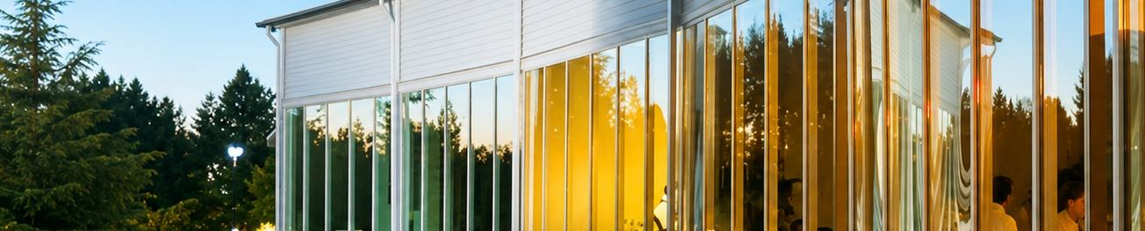
COMMITTEE · COMMUNITY EVENTS
Opportunities to meet your neighbors
Volunteers plan and staff every one of these — and you can help with just the ones that fit your schedule.
Summer Picnic
Community Garage Sale
Annual Meeting
The whole community, one afternoon
Neighborhood-wide, every August
November — elect your Board
Golf Cart Parade & Food Drive
Holiday Party
Wine Club & Winemakers Dinners
Decorate a cart, fill a food bank
Early December at the Clubhouse
Hosted at the Clubhouse through the year
The full calendar — committee meetings, board meetings and every event — lives on the Events page at ishoa.org.
Notes:
Name the next event coming up and who to talk to tonight if they want in.

Slide 27
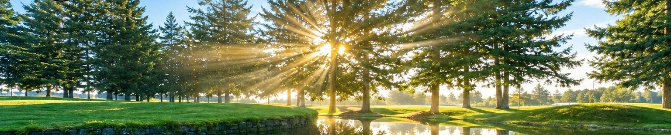

COMMITTEE · COMMUNICATIONS
Three ways we reach you
The team that keeps the whole community informed — and the one most open to new ideas and new tools.
ishoa.org
Text alerts
Signs at the gates
Built and updated weekly by residents: board contacts, committee pages, the events calendar, forms and documents.
The SMS program started in 2024. More than 300 homeowners now get time-sensitive news by text message.
Posted at the gate entrances for meetings, events and anything urgent.
The Communications Team also maintains the Resident Directory.
Sign up for text alerts
Scan the code with your phone camera — or go to splango.com/bjoin/101754
Notes:
Ask everyone to pull out a phone and sign up for text alerts right now. That single step solves most 'nobody told me' complaints.

Slide 28
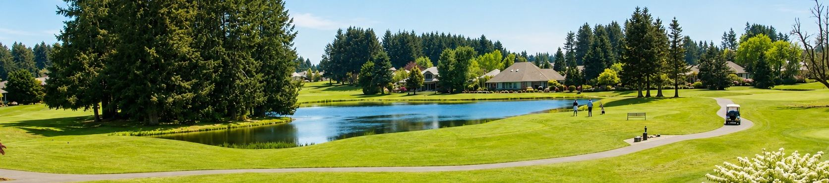
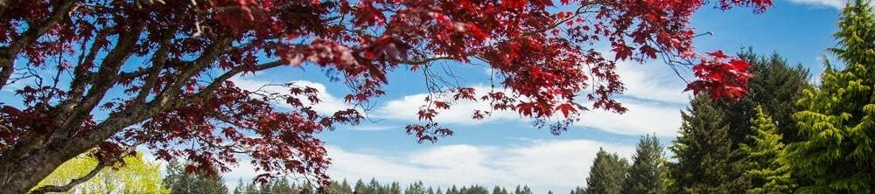
COMMITTEES · FINANCE AND CC&R REWRITE
The quiet work behind your dues
Two committees that shape what Indian Summer costs and how it is governed.
Finance Committee
CC&R Rewrite Committee
Advises the Treasurer and the Board on the budget, the annual audit, the Reserve Study and investment policy.
The Reserve Study is our long-range plan for replacing what we own — roads, ponds, gates — so the Association can avoid surprise special assessments.
Looking for residents with finance, accounting or budgeting experience.
Assists the Board in amending our CC&Rs and Bylaws — to meet new federal, state and local requirements and to say things in plainer English.
Reviewing what has worked since 1993, how other communities handle the same questions, the ISHOA / Golf Course relationship and RCW 64.90.
Adoption requires an affirmative vote of 320 homeowners.
Notes:
The 320-vote threshold is worth emphasizing — it means every homeowner's ballot genuinely matters.

Slide 29
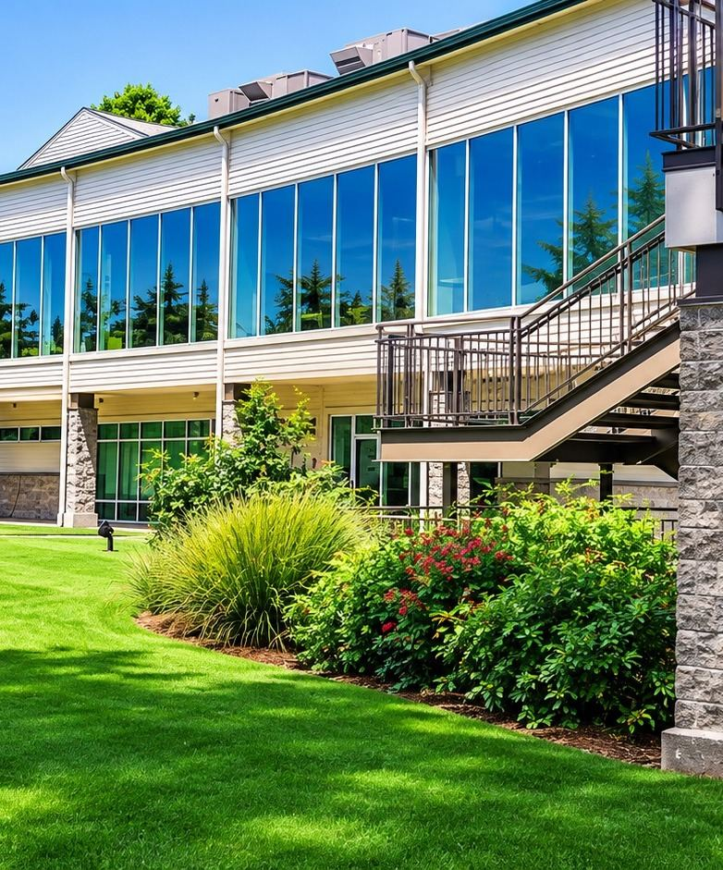
CLUBS & SOCIAL LIFE
Find your people
Four resident clubs meet regularly. No committee appointment required, just show up.
Book Club — first Wednesday of the month at 7 p.m., in members' homes
Mahjong — Wednesdays at 9:30 a.m. in the ladies' card room downstairs at the Clubhouse; new and experienced players welcome
Wine Club — monthly on Thursdays at 6:30 p.m. at the Clubhouse, hosted by the Golf & Country Club
Thirsty Thursdays — Embers Lounge, 5:30–7:30 p.m., cocktails and specials on appetizers
Clubhouse dinners — pasta nights, Winemakers Dinners and prime rib every Friday night — are on the Events calendar at ishoa.org, along with every club contact.
Notes:
Clubs are the lowest-commitment way into the community. Encourage brand-new residents to pick one this month.

Slide 30
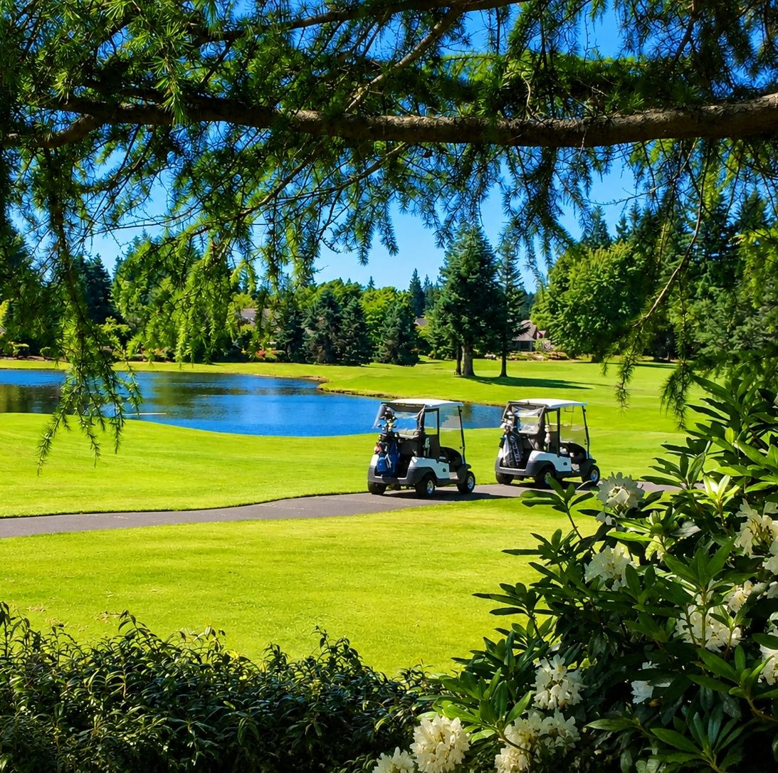
WEBSITE NAVIGATION
Everything is on ishoa.org
Eight tabs across the top — the one address worth remembering.
Home — next meeting, key phone numbers, "Notify Maintenance of a Problem"
Board — your five directors and the meeting schedule
Committees — click any tile to meet the volunteers behind it
Events — the full community calendar
Contacts — guardhouse, VIS, golf course, utilities, sub-HOA presidents
Forms — ARB applications, RFID gate card orders, request forms
Resident Directories — password protected
Hot News — anything urgent
Governing documents and financial reports live in the VIS FrontSteps portal, linked from the site.
Notes:
If a laptop is available, walk the site live for two minutes instead of reading this slide.

Slide 31

ISHOA.ORG · HOME PAGE
Start on the front page
Next meeting date and Zoom details, key phone numbers, and one-click buttons for the events calendar, text alerts, Hot News and reporting a maintenance issue.

Slide 32
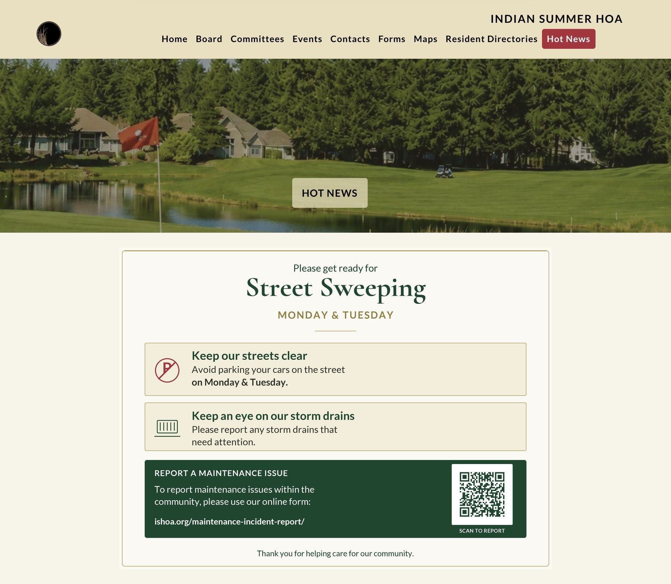
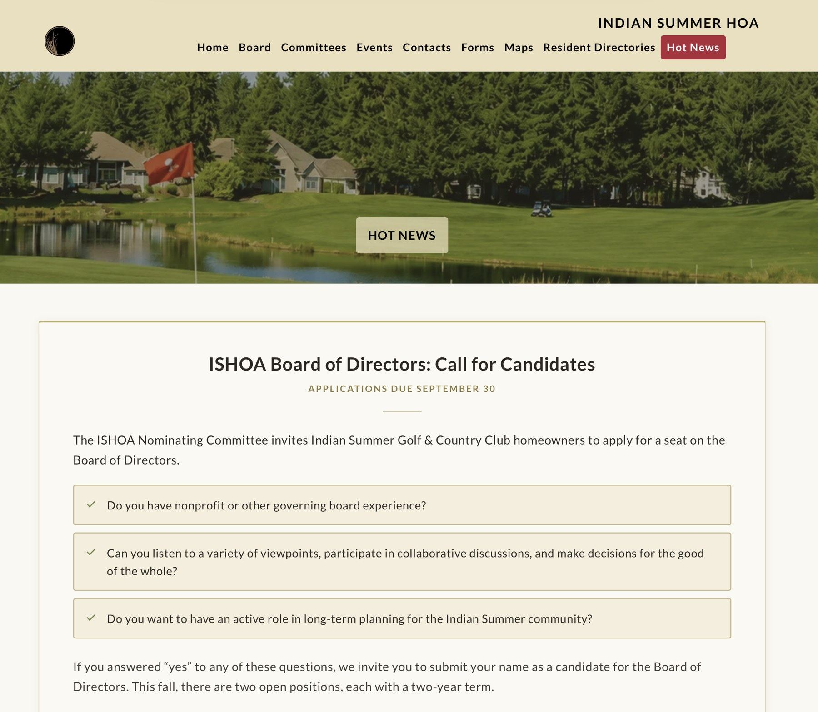
ISHOA.ORG · HOT NEWS
Anything urgent
Gate outages, road work, Board announcements and calls for candidates are posted here first. If something seems off in the neighborhood, check Hot News.

Slide 33
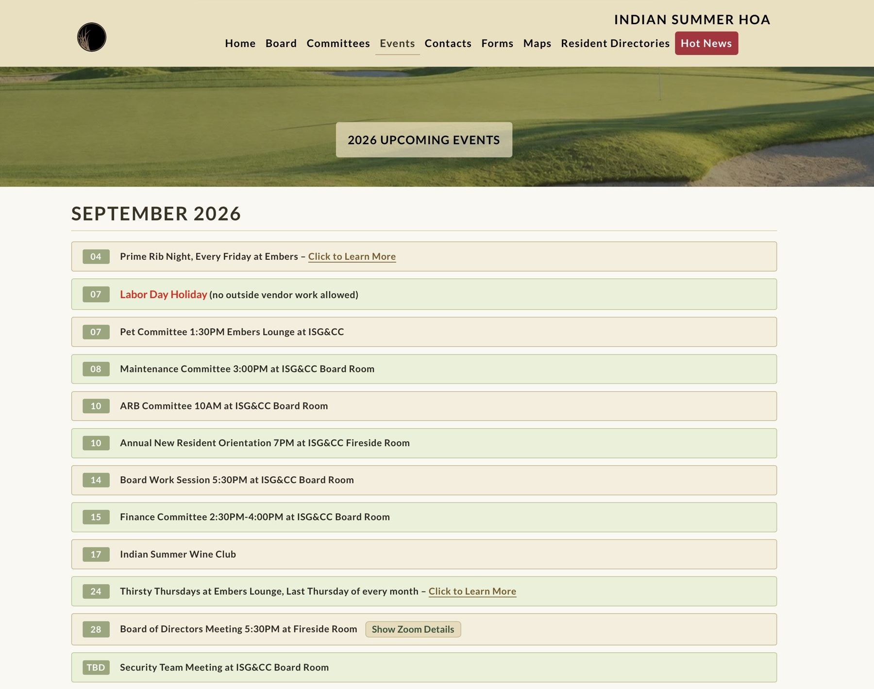
ISHOA.ORG · EVENTS
The community calendar
Every Board meeting, committee meeting, club night and social event, month by month. Click any entry for the time, location and Zoom details.

Slide 34
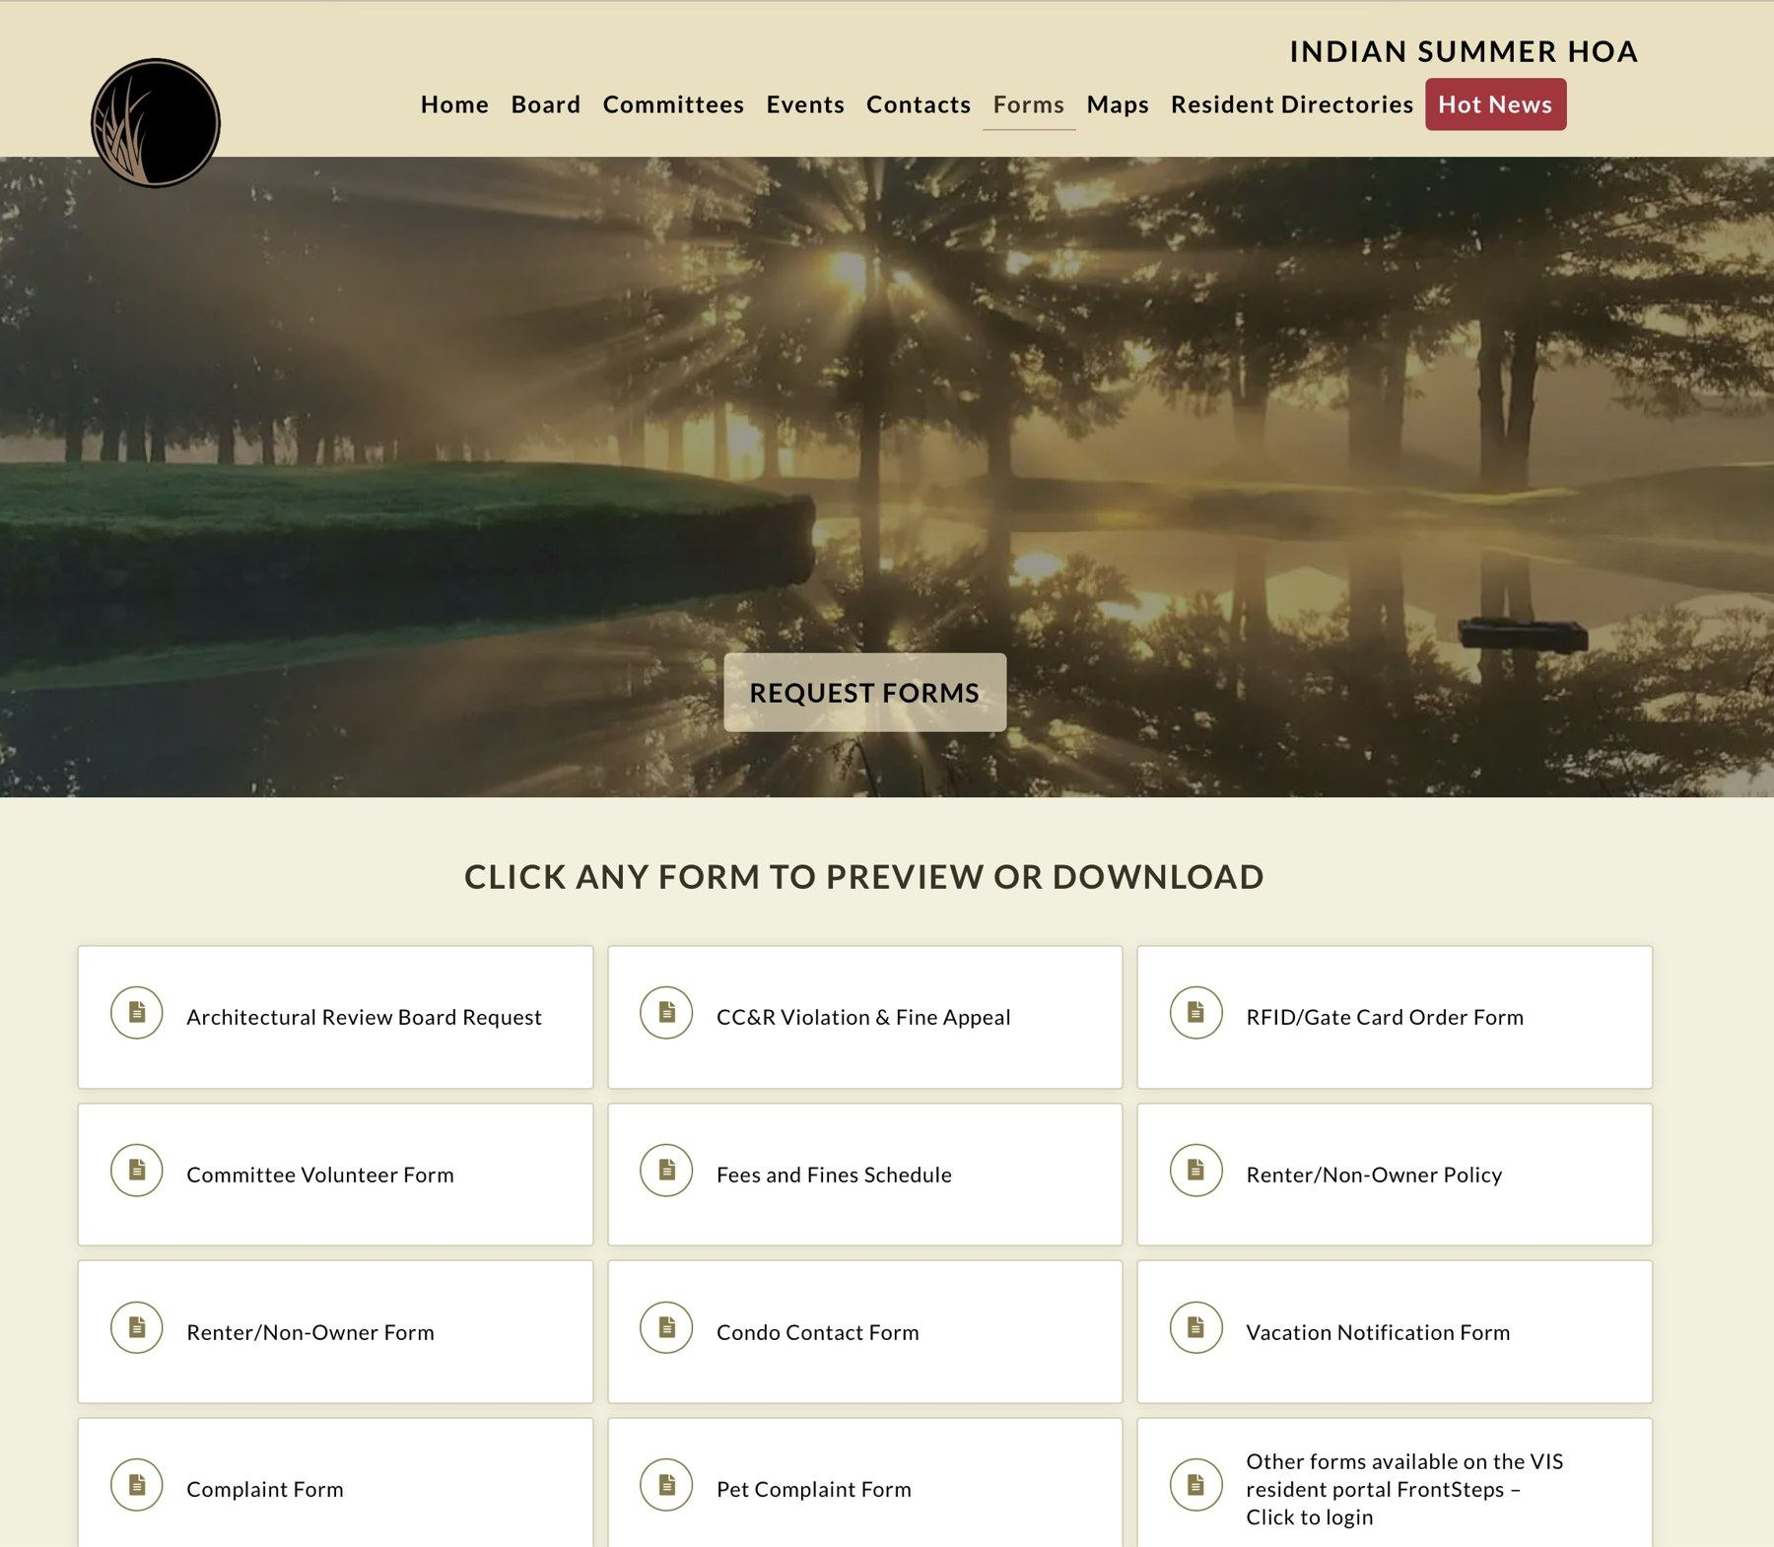
ISHOA.ORG · FORMS
Forms, ready to download
ARB applications, RFID and gate card orders, renter information, complaints and the committee volunteer application — fillable PDFs you can complete and send in.

Slide 35
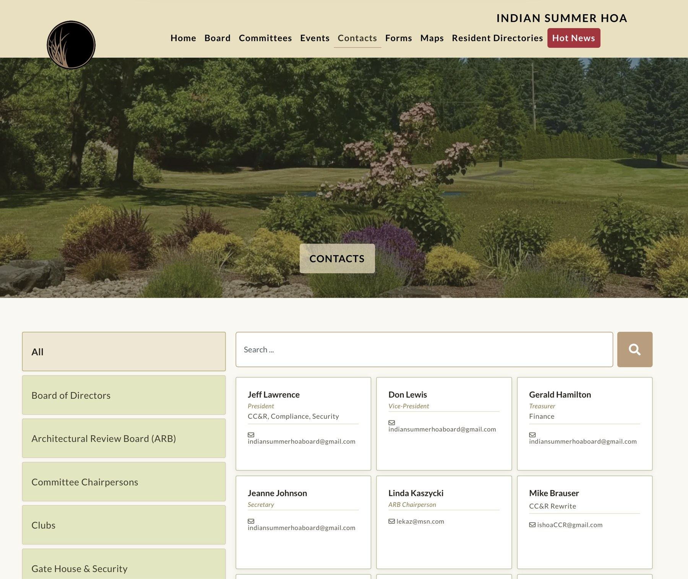
ISHOA.ORG · CONTACTS
Who to call
Board members, committee chairs, the gate house, VIS Management and sub-HOA contacts in one searchable list, with phone numbers and email.

Slide 36
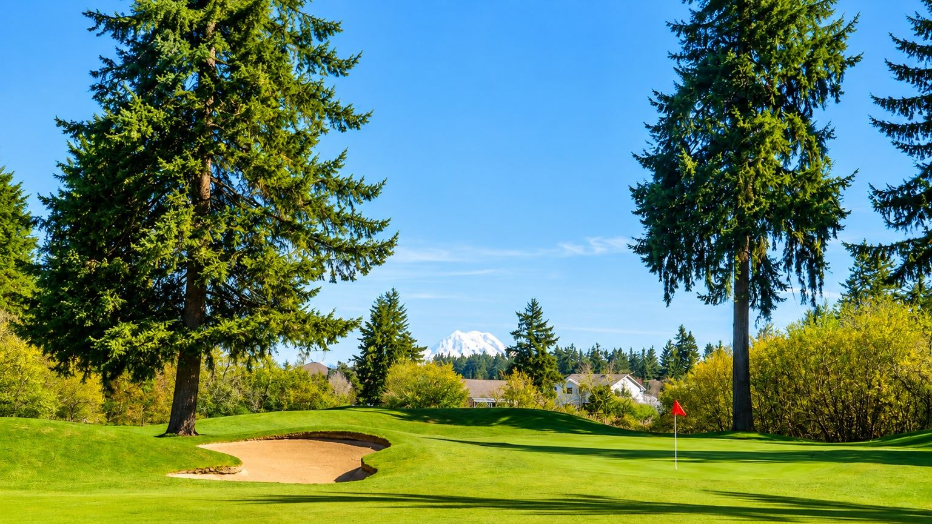
GETTING INVOLVED
Two hours a week
That is the average ask — about eight hours a month, and less in the quiet seasons. Committee members share the work, and contractors handle everything specialized or physical.
Whether you bring professional expertise, a particular interest, or simply a little time, there is a place for you. Even a few hours makes a real difference — and sharing the work among more residents makes volunteering easier for everyone.
Talk to any Board member — or email indiansummerhoaboard@gmail.com
Notes:
The close of the volunteer pitch. Invite people to sign the sheet or grab a Board member on the way out, and mention which committees have openings right now.

Slide 37
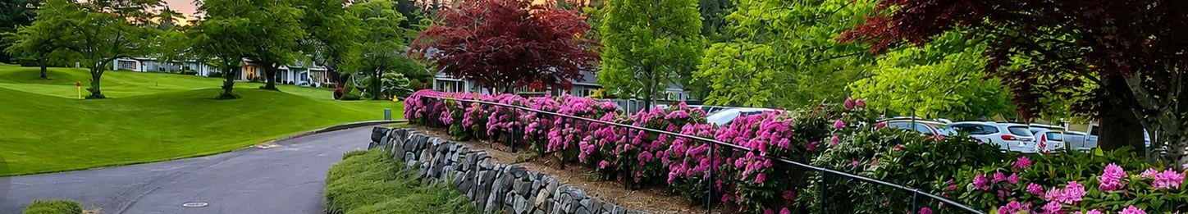
WHERE WE COULD USE YOU · 1 OF 2
Pick a committee, bring a neighbor
Our core volunteers have been at this for years — and they would love to see some new faces.
Maintenance
Finance
Pets
WHAT YOU'D DO
WHAT YOU'D DO
WHAT YOU'D DO
Stroll the pocket parks and common areas with an eye out for anything amiss — a branch down after a storm, a pond running high, a notice to post before street sweeping.
Look over budgets, reserve planning and the monthly financials with the committee, so the Board can make well-informed decisions on your behalf.
Spread the word about Puppy Parties, lend a hand at pet-friendly gatherings, tidy the park afterward, and keep the waste-bag dispensers stocked.
HELPFUL TO HAVE
HELPFUL TO HAVE
HELPFUL TO HAVE
A good eye and a willingness to walk the neighborhood. Handy with irrigation, construction or landscaping? Even better — but contractors do the heavy lifting.
A head for numbers and some patience for detail. Experience — or simply interest — in finance, accounting, budgeting or reserve studies.
A dog, a cat, or just a soft spot for the four-legged neighbors. Easily the friendliest way to meet people here.
VOLUNTEERS NEEDED
VOLUNTEERS NEEDED
VOLUNTEERS NEEDED
3 openings
2 openings
3 openings
Notes:
Point out that these three are very different kinds of help — a walk in the neighborhood, an afternoon with a spreadsheet, and a party with dogs. There is something here for nearly everyone.

Slide 38
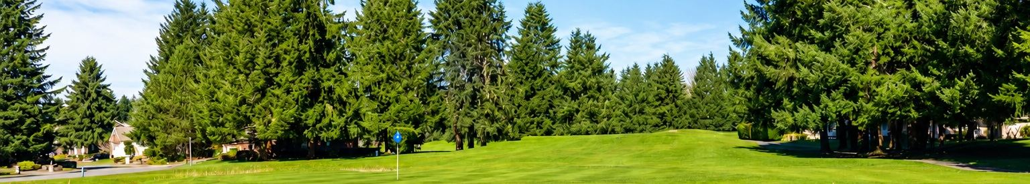
WHERE WE COULD USE YOU · 2 OF 2
Three more ways to jump in
Same deal — a couple of hours, good company, and a warm welcome from the regulars.
Security
Nature Preserve
Events
WHAT YOU'D DO
WHAT YOU'D DO
WHAT YOU'D DO
Help with traffic safety while crews work on the gates, gather details from neighbors reporting speeders or damage, and post the seasonal "Icy Roads" signs.
Keep an eye on the trail, the nest boxes and the sign boards. Trim a little overgrowth, refresh the species board, clean the wood duck boxes.
Planning, setup, decorating, registration or day-of help for the Garage Sale, Golf Cart Parade, Summer Picnic, Holiday Party and Annual Meeting.
HELPFUL TO HAVE
HELPFUL TO HAVE
HELPFUL TO HAVE
No security background needed. A level head and a habit of noticing things. You'll work alongside the Board and our service providers.
A love of being outdoors. Bring your boots and your binoculars — this one is more walk-in-the-woods than work party.
An appetite for a good party. Pick the one or two events that fit your calendar — nobody is signing up for all of them.
VOLUNTEERS NEEDED
VOLUNTEERS NEEDED
VOLUNTEERS NEEDED
2 openings
2 openings
3 openings
Notes:
Close by naming which of these six has the most immediate need tonight, and who in the room to talk to about each one.

Slide 39
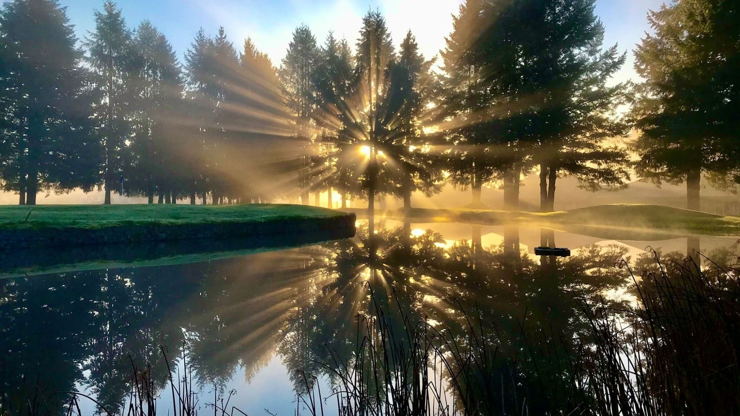
LIKE-MINDED NEIGHBORS, ONE PURPOSE
Let's make this the best
place you've ever lived
Friendly. Safe. Beautiful — and it takes all of us.
Indian Summer Homeowners Association · ishoa.org · Welcome home.
Notes:
Close warmly. Thank the volunteers by name. Invite everyone to stay for refreshments and to meet the committee chairs.

